Slide 2
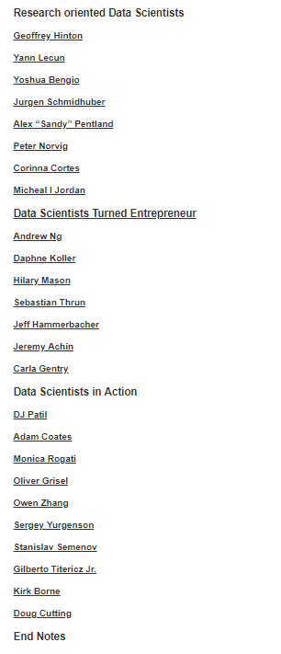
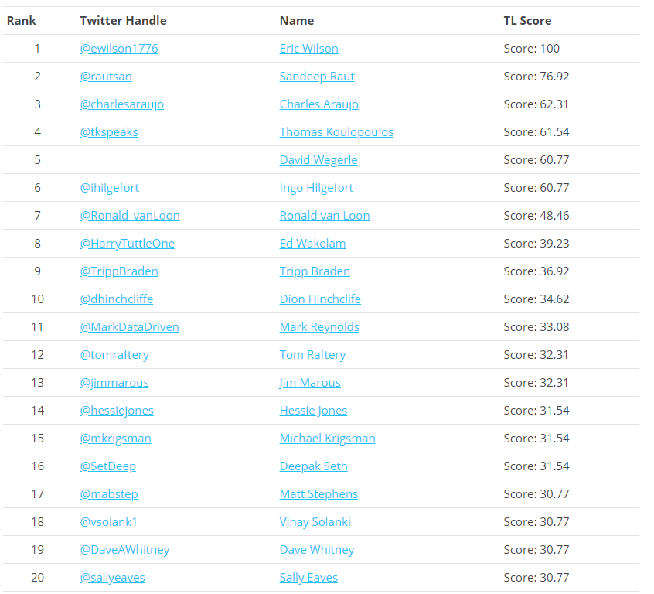
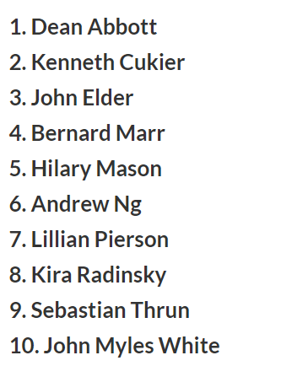
A : https://www.thinkers360.com/top-20-global-thought-leaders-on-analytics-july-2018/
C : https://techbeacon.com/enterprise-it/10-influential-data-scientists-why-you-should-follow-them-twitter
D :https://www.analyticsvidhya.com/blog/2015/09/ultimate-data-scientists-world-today/

